Slide 1
WebGL Without Frameworks
An introduction

Slide 2
The History of the GPU

Slide 3
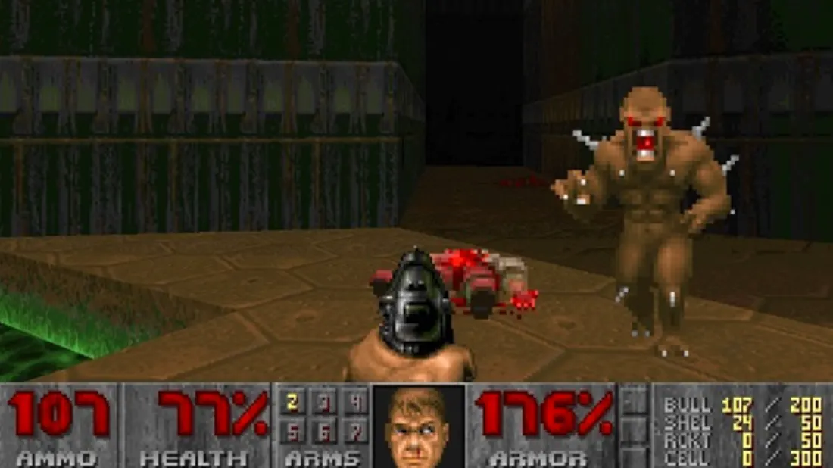
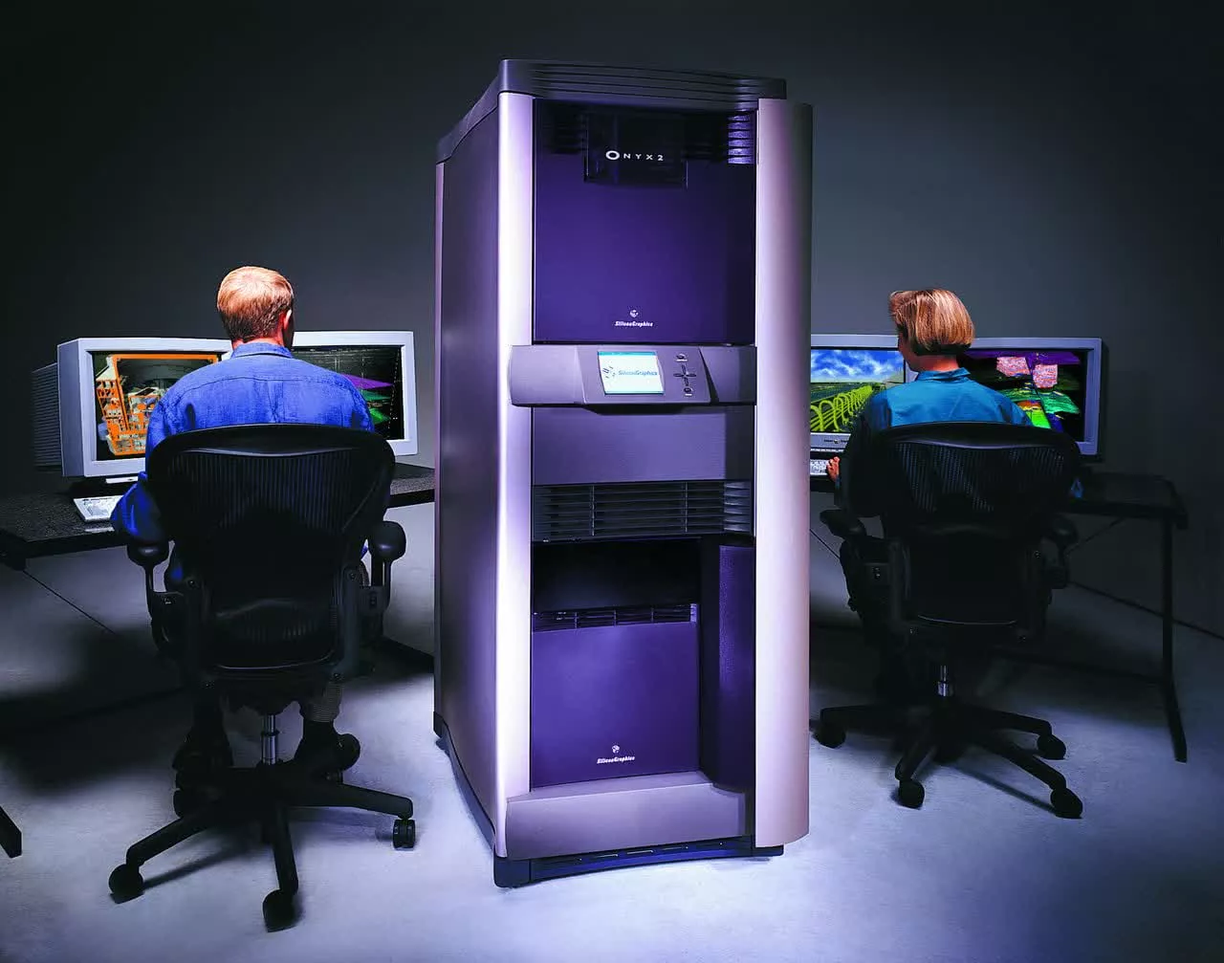
The Software Rendering Era
Early to mid 1990s
3D rendering hardware is prohibitively expensive
Only practical option for fast 3D was software rendering
Limitations
640x480 resolution == 307,200 pixels per frame
CPU can only draw 1 at a time
60fps x 307,200 == 18 million pixels per second
Gets worse as resolution increases
Hogs CPU time needed for other tasks
Rendering limited by CPU speed

Slide 4
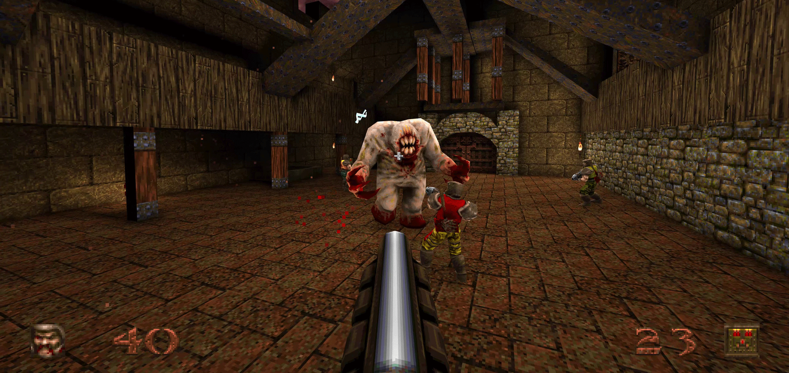
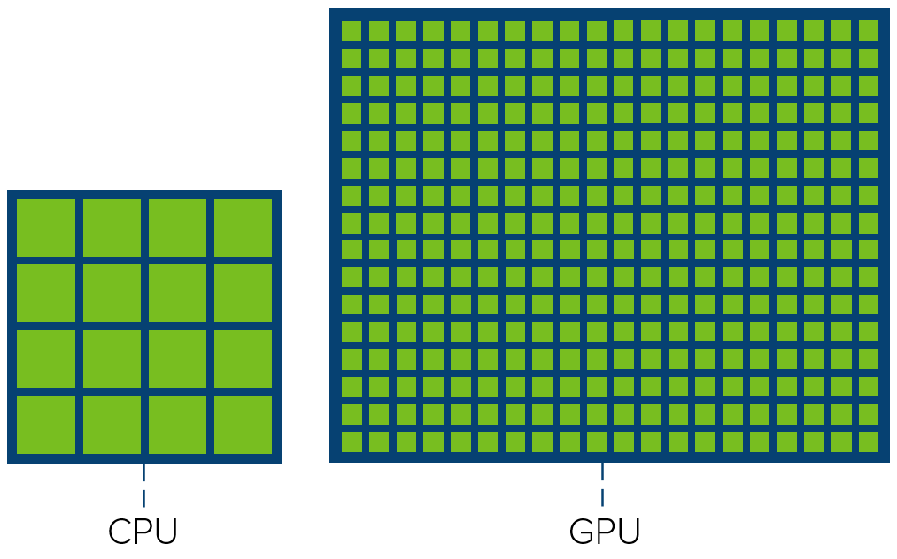
Enter the GPU
3D games like Quake created a market for affordable rendering hardware
Graphics Processing Unit (as we know it) was born
Design is fundamentally different from CPU
CPU: small number of large cores
GPU: large number of smaller cores
CPU: general-purpose
GPU: specialised for rendering
Advantages
Many pixels can be rendered in parallel
Asynchronous (frees up CPU for other tasks)

Slide 5








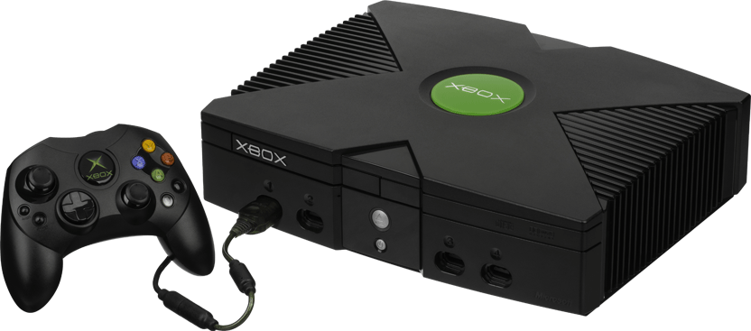

Evolution of API standards
Many different manufacturers of 3D cards
APIs were manufacturer-specific and proprietary
Time consuming, and locked developers in
SGI open sourced IRIS GL API as OpenGL
Backed by John Carmack, quickly rose to dominance
Microsoft followed with DirectX, caught up eventually

Slide 6

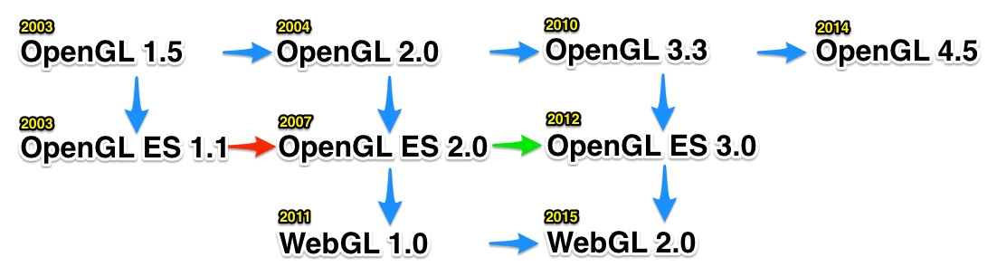
Present Day
Many subsets of OpenGL
OpenGL ES for embedded systems
“Most widely deployed graphics API in history”
WebGL derived from OpenGL ES
WebGL 2.0 released in 2015

Slide 7
The WebGL API

Slide 8
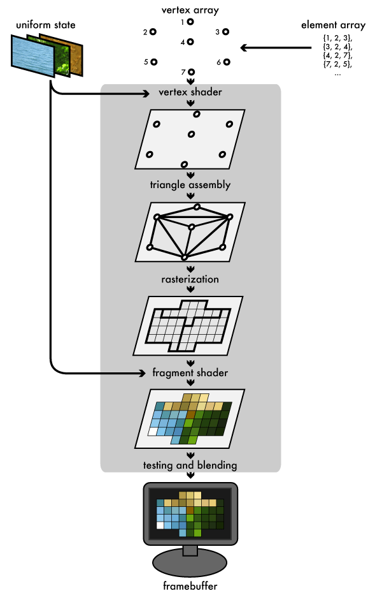
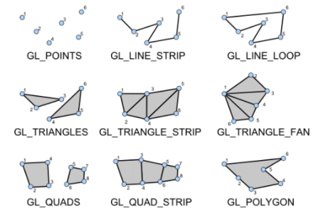
Overview
API access to GPU from Javascript
Agnostic of hardware
Only renders primitives – points, triangles etc.
Programmable pipeline (shaders)
Shader program runs on GPU
API focused on setting up shaders + feeding them with data

Slide 9
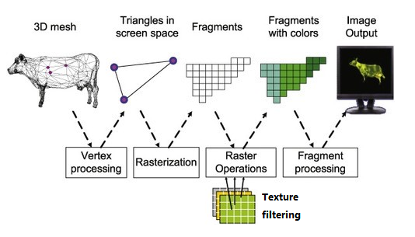
Shaders
Shaders make up the GPU program
GLSL - strict, specialised C-like language
2 main types:
Vertex shader
Fragment shader
Runs first (before fragment shader)
One iteration per vertex
Input is data we supply via WebGL API
Output is screen coordinate of the vertex
Runs second (after vertex shader)
One iteration per fragment (a.k.a. pixel)
Input is interpolated vertex shader output
Output is fragment colour

Slide 10
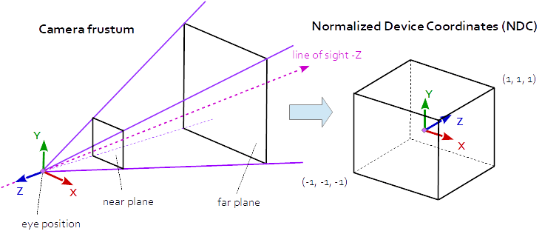
Coordinate System
Right-handed coordinate system
Near and far clipping planes

Slide 11

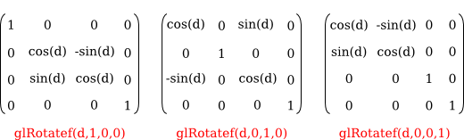

Transforms
Model vertices are defined in local space (relative)
Converted to screen coordinates using “transforms”:
Translation (position)
Rotation
Scaling
Projection
Uses matrix multiplication
Matrices are useful, but confusing
Don’t worry, gl-matrix can help us
Order of multiplications is critical

Slide 12
Demo

Slide 13
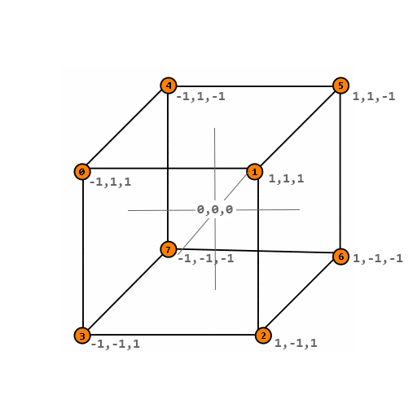

Slide 14
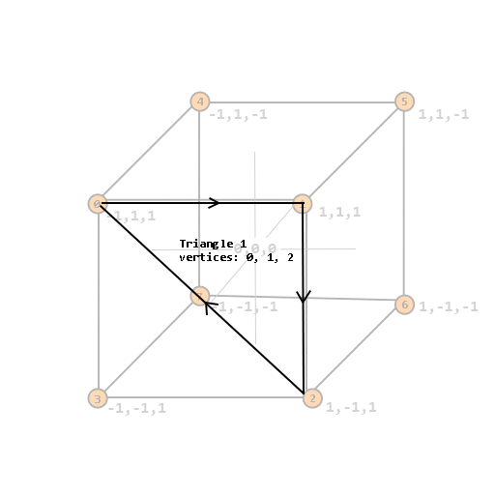
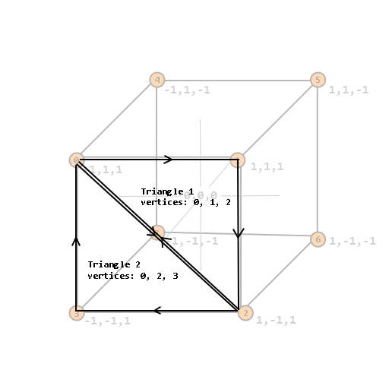

Slide 15
More WebGL Features

Slide 16
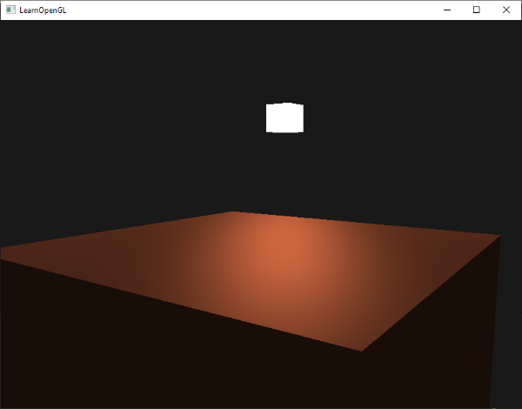
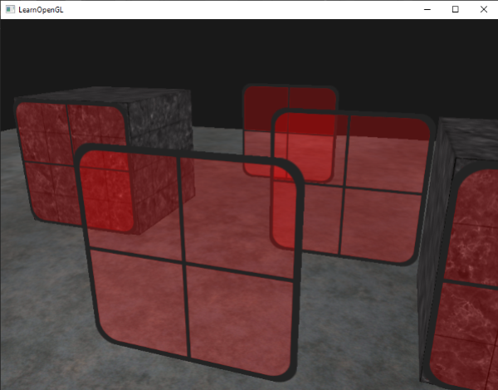
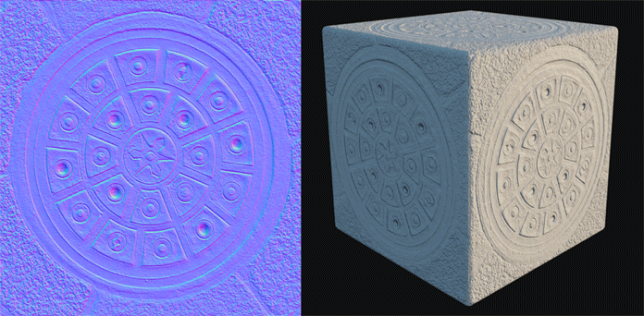


More WebGL features
Lighting
Transparency and blending
Cubemaps and environment maps
Normal maps, parallax maps, refraction etc.
Almost endless possibilities with shaders (SSAO)
WebGL 2.0
3D textures
Async queries (query data from GPU back to CPU)
Non power-of-two texture dimensions
More matrix functions
Instanced rendering
And many more…

Slide 17
Further reading
https://webgl2fundamentals.org
https://developer.mozilla.org/en-US/docs/Web/API/WebGL_API/Tutorial
https://jsantell.com/model-view-projection/
https://learnopengl.com/Getting-started/Hello-Triangle

Slide 18
Questions

